Slide 1

Rak’n’Roll

Slide 2
Rak’n’Roll was created to change the way we think and speak about cancer
and to improve the lives of those who are struggling with the disease, especially women.
We aim to create a new quality of communication about cancer on the public forum, by breaking all the taboos that surround cancer in Poland.
We try to find gaps in the system and create projects that are unique to our Foundation.
We support those who are struggling with the disease, we are present
in oncological clinics, we organize special beauty workshops and we educate
our society through numerous projects.
For us the most important thing is positive energy, a smile and the joy
of living.

Slide 3
Divine Mothers

Slide 4
Divine Mothers – how it all began
There is a wide spread assumption that cancer and pregnancy cannot
be reconciled.
Doctors lack the knowledge how to approach this problem and find the right solution. Therefore 3 out of 4 women are encouraged to have an abortion to start treatment.
The number of women in such a situation is growing due to two factors:
- increase in cancer patients amongst younger women
- more women decide to have a child at an older age

Slide 5
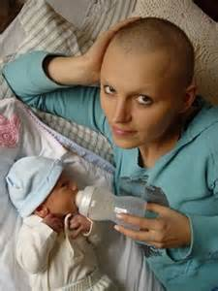
Divine Mothers
Our founder, Magda Prokopowicz became pregnant while struggling with breast cancer. Many doctors, both locally and abroad, recommended an abortion
in order to continue treatment. However, she felt internally that there was another way.
Her success inspired her to talk broadly about the problem and find a solution.
Her biggest dream was to create a place where pregnant women with cancer could find professional help and support.

Slide 6
Divine Mothers
Why Divine Mothers? There women have great love for their unborn child and the courage to fight against the system.
We designed a program, called Divine Mothers in order
to give complex care to pregnant women struggling with cancer.
Our program is especially designed to work with doctors, oncologists, obstetricians, psycho oncologists, so that every woman that comes to us has the right experts to guide her through this process.
We also have the support of dieticians, wig makers and make-up artists, to give them more comfort with the way they look during or after the illness.
The program is free, all the funds needed are raised by us and come from donors that find this program worth supporting.

